Slide 1
PRDA-01 Profit Analysis
RAAJASOUNDHAR.r
PROJECT TEAM ID- “PTID-CDA-SEP-23-033”

Slide 2
Dataset
The dataset holds data from 50 start-ups in New York, California, and Florida. The features in this dataset are R&D spending, Administration Spending, Marketing Spending, location features, and Profit.
Attribute Information:
R&D spending: The amount which startups are spending on Research and development.
Administration spending: The amount which startups are spending on the admin panel.
Marketing spending: The amount which startups are spending on marketing strategies.
State: To which state that particular startup belongs.
Profit: How much profit that particular startup is making.

Slide 3
Multiple Linear Regression Analysis
Regression models are used to describe relationships between variables by fitting a line to the observed data. Regression allows you to estimate how a dependent variable changes as the independent variable(s) change.
Multiple linear regression is used to estimate the relationship between two or more independent variables and one dependent variable.
We use multiple linear regression when to know how strong the relationship is between two or more independent variables and one dependent variable.

Slide 4
Multiple Linear Regression Analysis
Here there are 3 independent variables:
R&D Spendings
Administrative Spendings and
Marketing Spendings
The dependent variable is Profit which is dependent on Marketing, R&D and administration spendings.
Here R squared value is 0.95 which means our value indicates that the model predicts 95% of the relationship between dependent and independent variables.

Slide 5
PROFIT FOR THE BELOW-GIVEN INPUT FEATURES.
R&D Spend | Administration | Marketing Spend | Profit
21892.92 | 81910.77 | 164270.7 | 70037.90477
23940.93 | 96489.63 | 137001.1 | 70554.57256

Slide 6
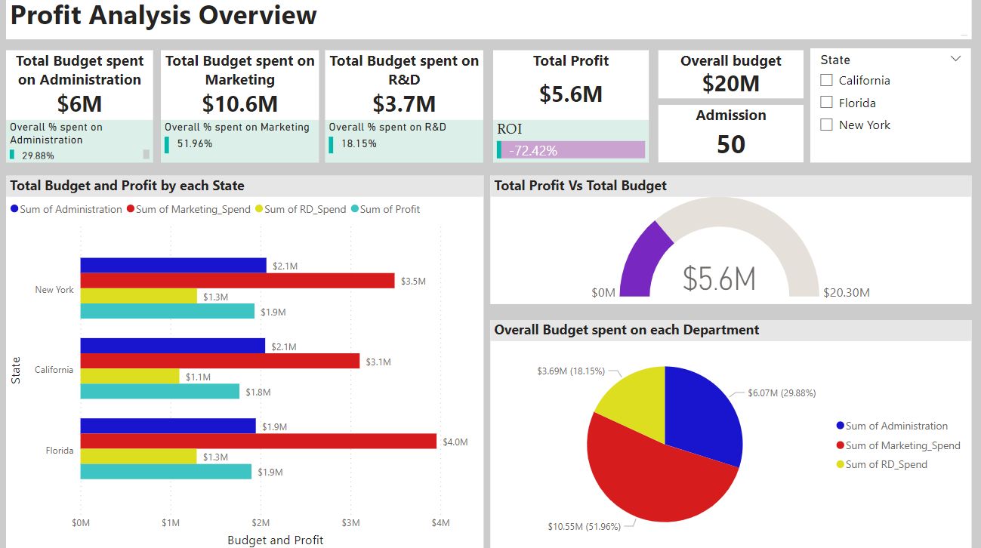
Power BI Report

Slide 7
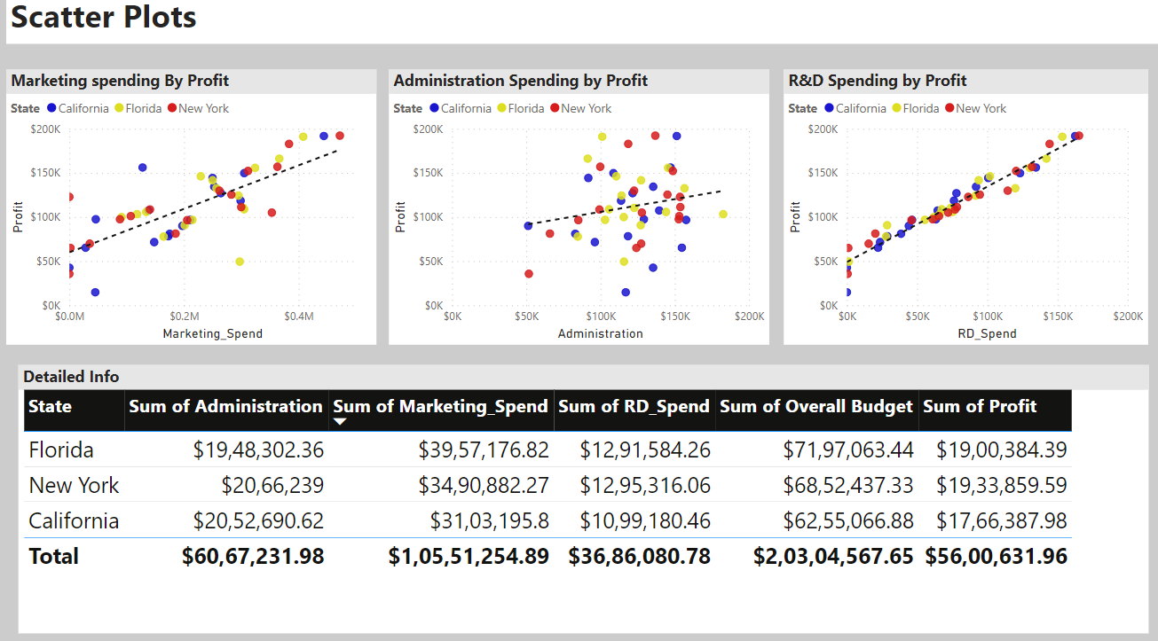
Power BI Report

Slide 8
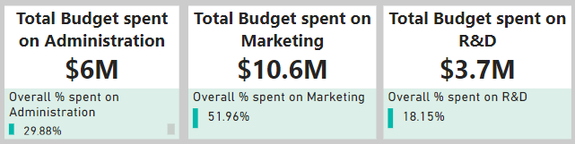
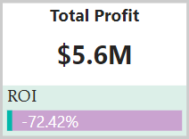
Insights
Overall budget spent by 50 startups in 3 regions
Overall budget spent- $20M
Marketing-$10.6M and 51.96% of overall budget
Administration-$6M and 29.8% of overall budget
R&D-$ 3.7M and 18.1% of overall budget
The company spent more on Marketing
Profit is $5.6M and ROI is -72.42%

Slide 9
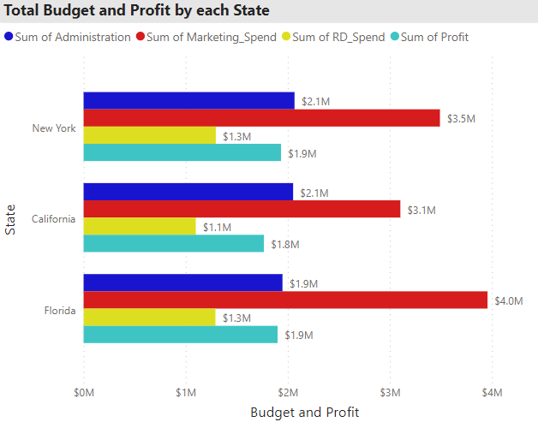
Insights
New York is having more profit, followed by Florida and California.

Slide 10
Insights
The company is in loss despite having huge marketing. I would advise to cut cost on marketing and administration and improve the product with R&D.

Slide 11
Thank You

